Slide 1
A Predictive Model for Marketing Campaign Responses
Martize T. Smith
Data Science Project
Springboard
3/2/2024

Slide 2
why should we care?
Significance:
Business drives economies and makes them stronger
Businesses create jobs for the mass populations
Data science and applications enhance the success of businesses
Predictive modeling that guides marketing is a major impact on business success

Slide 3
Agenda & expectations
Agenda:
Intro, Overview of Data Science & Project Work Flow
Expectations:
Real World Scenario
The problem being solved acts as a training resource for Data Scientists
Data results shown later can be improved due to skeness

Slide 4
Introduction
Purpose: to discover factors that contribute to customer’s response from business marketing campaigns then construct a logistic regression predictive model
Data Science is used to help build predictive models to direct business actions that give the highest yield on desired result
Data Science Framework: (1) Business Understanding (2) Data Understanding (3) Data Prep (4) Model (5) Evaluation
Bus. Und. = clarify business objectives; Data Und. = examine data source; Data prep = clean & explore; Model = Logistic Regression; Eva. = Confusion matrix, gains chart & accuracy

Slide 5
Business Understanding
Project Overview: Examine customer data to determine correlations to customer marketing response then create predictive model
Businesses are actively looking for more competitive advantages and even a supreme unfair advantage so they can accomplish market dominance.
Regardless of the desired end goal observing this project will help act as one of many resources that contributes to helping businesses find a way to get greater outcomes in their marketing goals

Slide 6
Data understanding
Data Source: Kaggle data set
Marketing data from one company
Data consists of 39 columns of 2205 customer’s information & demographics along with other data like but not limited to the company’s marketing campaigns responses and marketing channels.

Slide 7
Data preparation
Applied the Cross Industry Standard Process for Data Mining (CRISP-DM) to express methods used
1) Select independent and dependent variables (2) Visualize data & analyze (3) Identify correlations (4) Build logistic regression model (5) Evaluate Model
Data Cleaning: Checked for Duplicates, Checked for Wrong Data Types, Checked for Missing Values & Checked for Irrelevant Data
Data Explore: Box-plots, Combination bar & line plot & heatmap correlation matrix

Slide 8
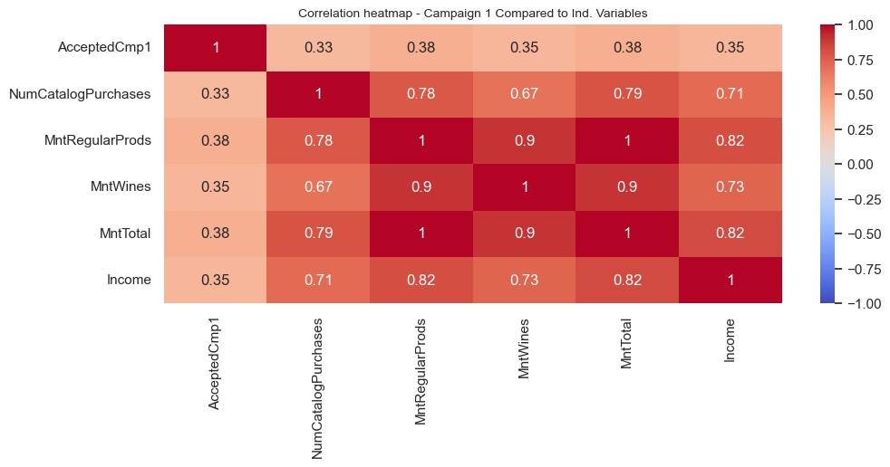
Heatmap correlations
Highest Correlations to Marketing Campaign 1 (From Highto Low)
MntTotal
MntRegularProds
MntWines
Income
NumCatalogPurchases

Slide 9
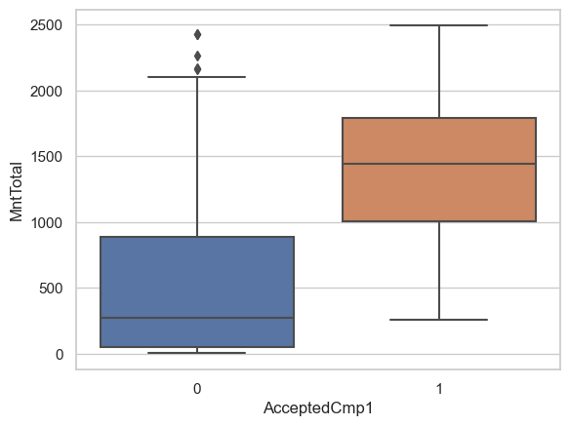
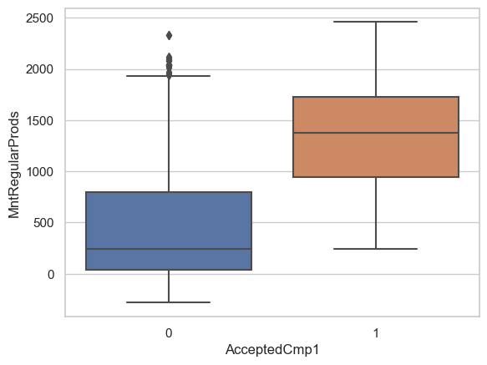
data explore
Box-Plot: average total amounts spent in total in the last 2 years from customers during campaign one last 2 years
Box-Plot: average amounts spent on regular products from customers during campaign one last 2 years

Slide 10
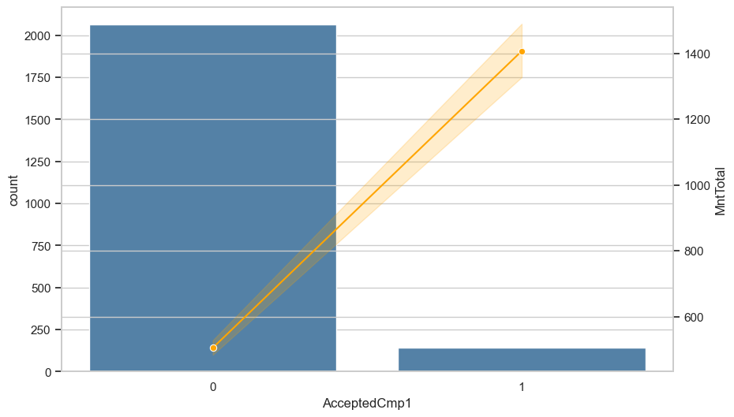
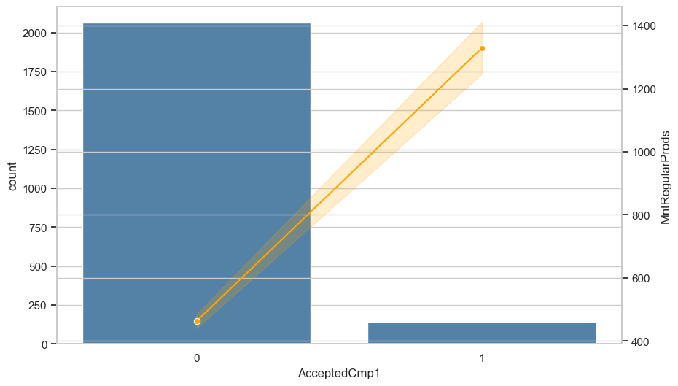
Data explore
Combo chart: average total amounts spent in total in the last 2 years from customers during campaign one last 2 years
Combo chart: average amounts spent on regular products from customers during campaign one last 2 years

Slide 11
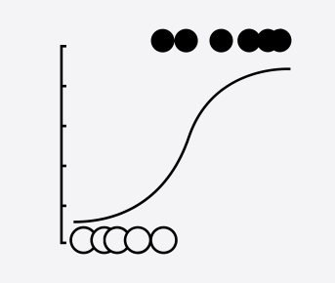
model
Logistic Regression Model
Logistic regression approximates the chance of an event taking place using given independent and dependent variables
Uses variable relationships to predict the value of one of those factors based on the other

Slide 12
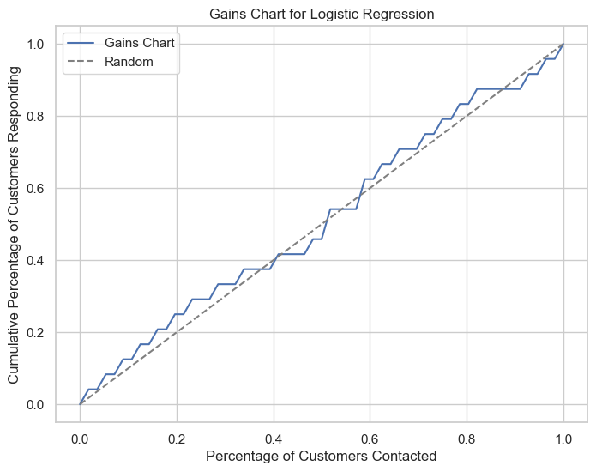
Model & evaluation
The dashed line expresses “no gain” so its what companies would expect to achieve by marketing to customers at random.
The nearer the cumulative gains line is to the top-left corner of the chart the bigger the gain so the higher the amount of the customer’s responding that are reached for the lower amount of customers contacted.

Slide 13
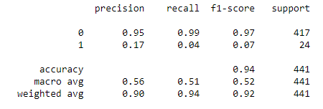
Classification report

Slide 14
Conclusion & Future Improvements
Regression model accuracy score is 94% but doesn’t mean it’s a supreme model
Improvements will be as follow:
Add more data from current and new incoming customers to help give greater insights.
Use more advanced evaluation techniques to uncover more areas that could be targeted to enhance model.
Use different algorithms to broaden the scope of the predictive model’s performance then compare all to find the optimal model to act as the model of choice.

Slide 15
References
Blattberg, R.C., Kim, BD., Neslin, S.A. (2008). The Predictive Modeling Process. In: Database Marketing. International Series in Quantitative Marketing, vol 18. Springer, New York, NY. https://doi.org/10.1007/978-0-387-72579-6_10
Gabriela Alves Werb and Martin Schmidberger (2021) Predictive Modeling in Marketing, 376 - 396
Maciej Łobiński, Piotr Tarka (2014) Decision Making in Reference to Model of Marketing Predictive Analytics – Theory and Practice, 60 - 69
Sadrnia, L. (2023) The Future of Marketing: How Predictive Modeling Optimizes Campaign Strategies. iBusiness, 15, 249-262. doi: 10.4236/ib.2023.154018
https://github.com/visionary1001/all-projects-in-springboard-/blob/1262344c4de63b76b3bfd1bd0fdacd62560235ef/Capstone2_Presentation%202nd%20Submit.pptx

